Slide 1

Jingwei Wu, PhD
Chapter 4
Standard Scores, the Normal Distribution, and Probability
A courtesy of “USING AND INTERPRETING STATISTICS” by ERIC W. CORTY | THIRD EDITION (Macmillan Education)

Slide 2

Objectives
Standard Scores (z Scores)
The Normal Distribution
Percentile Ranks
Probability

Slide 3
Standard Scores (z Scores)
Standard Score
A raw score expressed in terms of how many standard deviations it falls away from the mean; also known as a z score
z Score
A raw score expressed in terms of how many standard deviations it falls away from the mean; also known as a standard score

Slide 4
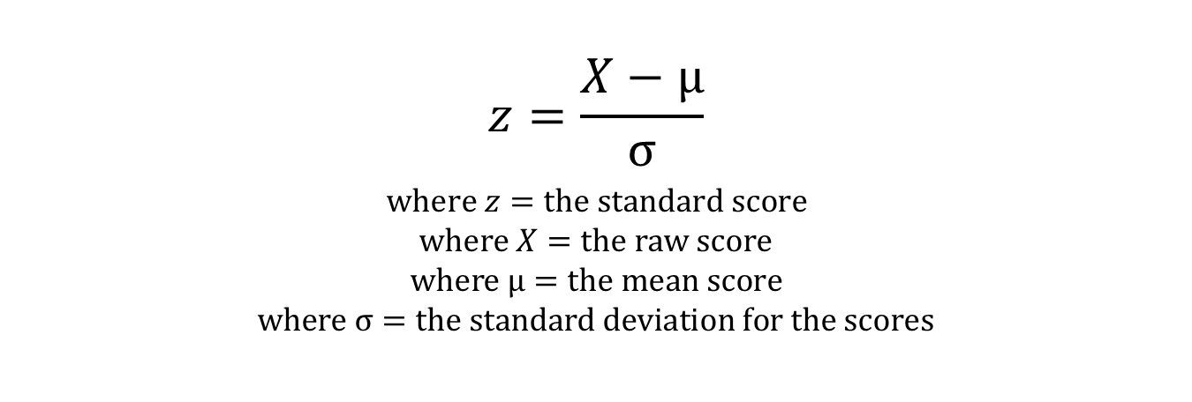
Standard Scores (z Scores)
Two Steps:
Subtract the mean from the raw score.
Divide the deviation score by the standard deviation and round to 2 decimal places.
Formula
$$z=\frac{X−µ}{σ}$$
$$where z=the standard score$$
$$where X=the raw score$$
$$where µ=the mean score$$
$$where σ=the standard deviation for the scores$$

Slide 5
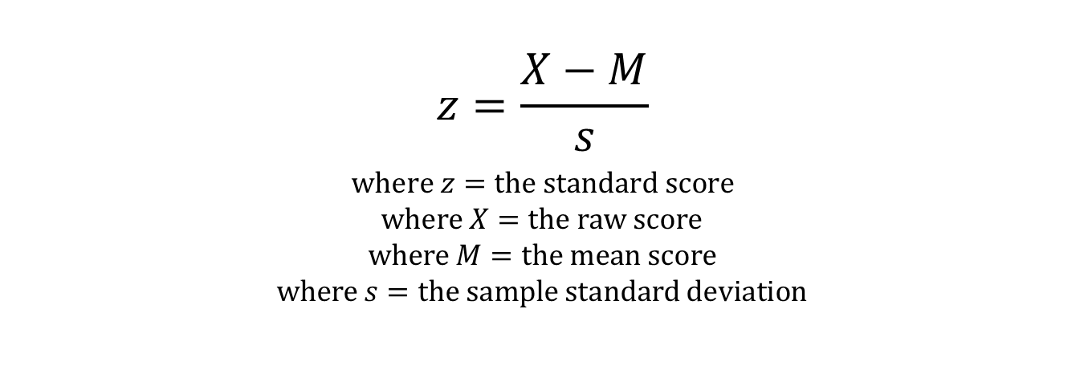
Standard Scores (z Scores)
Same Two Steps:
Subtract the mean from the raw score.
Divide the deviation score by the standard deviation and round to 2 decimal places.
Formula
$$z=\frac{X−M}{s}$$
$$where z=the standard score$$
$$where X=the raw score$$
$$where M=the mean score$$
$$where s=the sample standard deviation$$

Slide 6
Standard Scores (z Scores)
Example
Demographer selects 5 adult Americans
M = 67.00″ and s = 4.18″
One member is 62”
z score formula
See Table 4.1 for remaining z score calculations
Heights of Five Americans, Expressed as Standard Scores
Height (X) | Deviation Score (X−M) | z Score
62 | −5.00 | −1.20
65 | −2.00 | −0.48
66 | −1.00 | −0.24
69 | 2.00 | 0.48
73 | 6.00 | 1.44

Slide 7
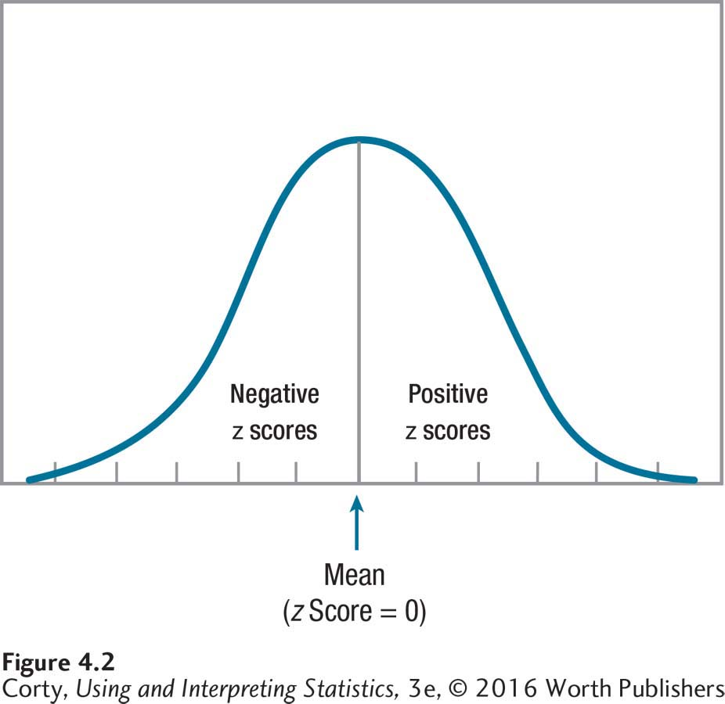
Positive, Negative, and Zero z Scores
Another term for “standard score” is z score.
Positive value for a z score means that the score falls above the mean.
Negative value means that the score falls below the mean.
Value of 0 means that the score falls right at the mean.

Slide 8
Standard Scores (z Scores)
Example
Demographer selects 5 adult Americans
M = 67.00″ and s = 4.18″
One member is 62”
z score formula
See Table 4.1 for remaining z score calculations
Heights of Five Americans, Expressed as Standard Scores
Height (X) | Deviation Score (X−M) | z Score
62 | −5.00 | −1.20
65 | −2.00 | −0.48
66 | −1.00 | −0.24
69 | 2.00 | 0.48
73 | 6.00 | 1.44

Slide 9
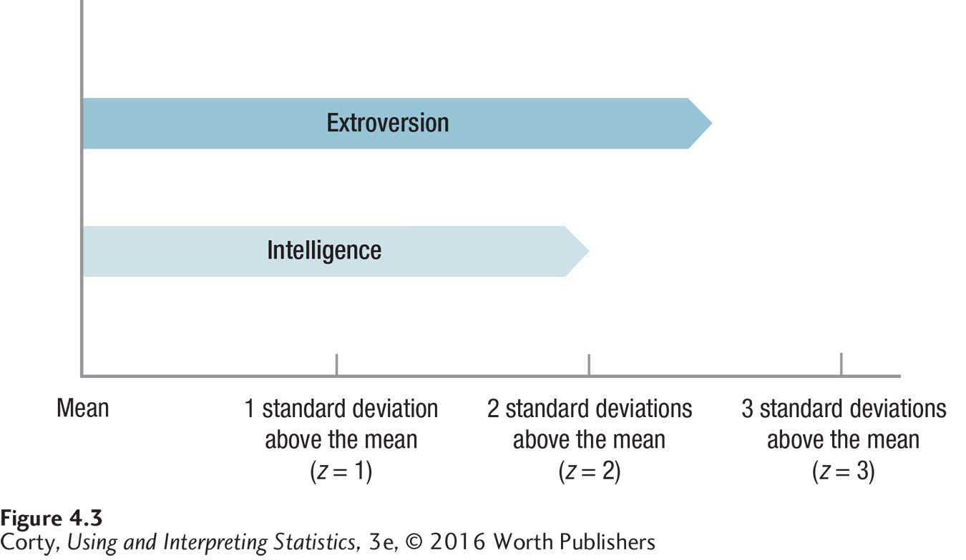
Standard Scores (z Scores)
Example: Carlos is smart and extroverted:
Does Carlos have more intelligence or more extroversion?
Calculate z scores.
Carlos’s Scores on an Extroversion Scale and an Intelligence Test

Slide 10
Examples: How to Use Formula
Mei-Li’s extroversion score
z score = 1.00, M= 50.00, s = 10.00
Tabitha’s IQ test score
z score = −0.75, M= 100.00, s = 15.00
Formula Calculating Raw Score (X) from a Standard Score (z)
X = M + (z x s)

Slide 11
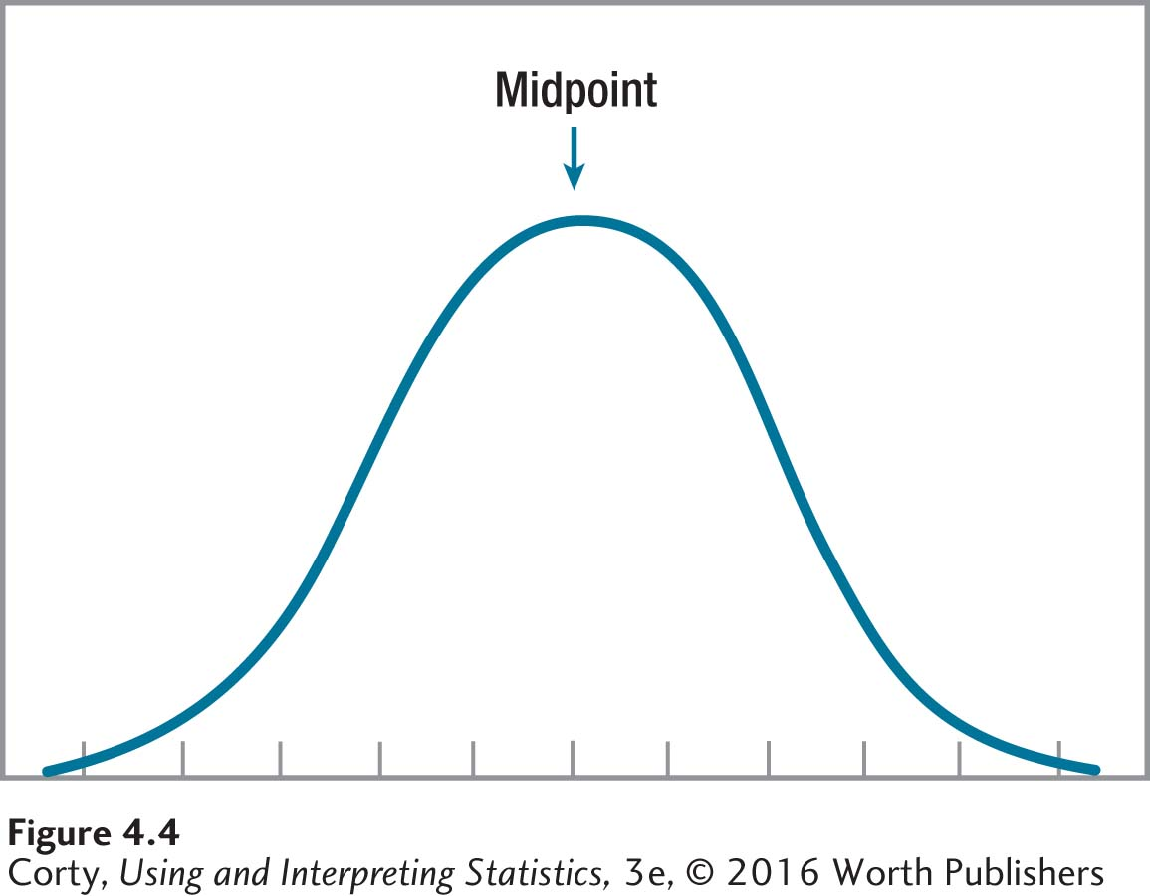
The Normal Distribution
Normal Distribution
Specific bell-shaped curve that is defined by the percentage of cases that fall in specific areas under the curve
Figure 4.4
A normal distribution is a symmetrical distribution.
Midpoint is the mean, median, and mode.
As scores move away from the midpoint, the frequency of their occurrence decreases symmetrically.
The Normal Distribution

Slide 12
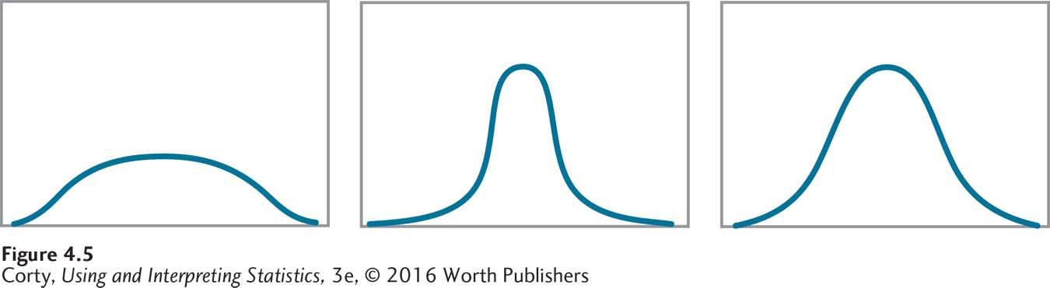
Not All Bell-Shaped Curves Are Normal Distributions
Various types of bell-shaped curves
Midpoint is the mean, median, and mode.
Frequencies decrease symmetrically as values move away from midpoint.
Distributions are symmetrical.
All curves shown here are bell-shaped; not all are normal distributions
Only curve C is a normal distribution
A
B
C

Slide 13
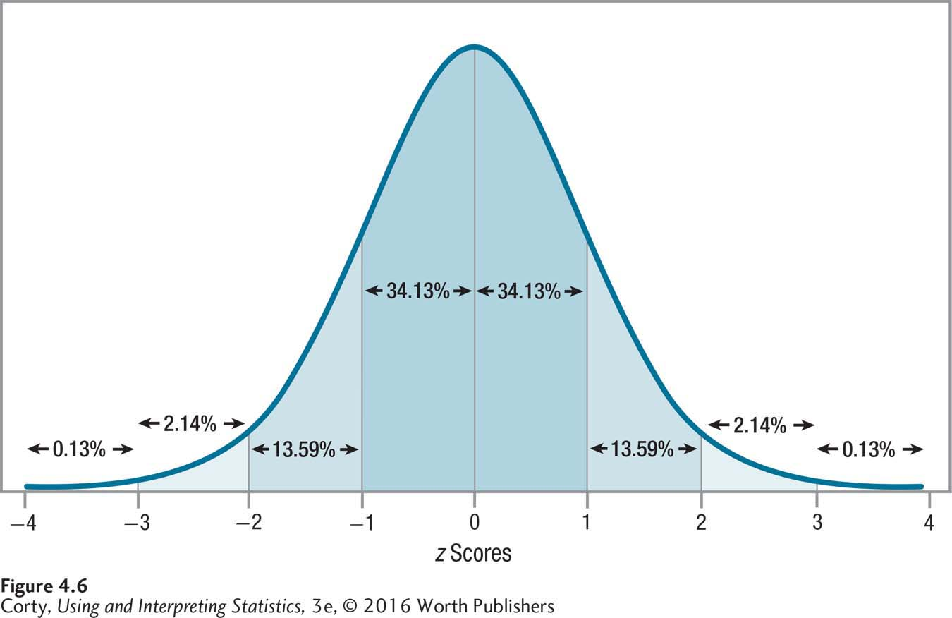
Normal Distribution
Normal distribution defined by the percentage of cases that fall within specified regions
Figure shows percentage of cases that fall in each standard deviation as one moves away from the mean
Percentage of Cases Falling in Specified Regions of the Normal Distribution

Slide 14
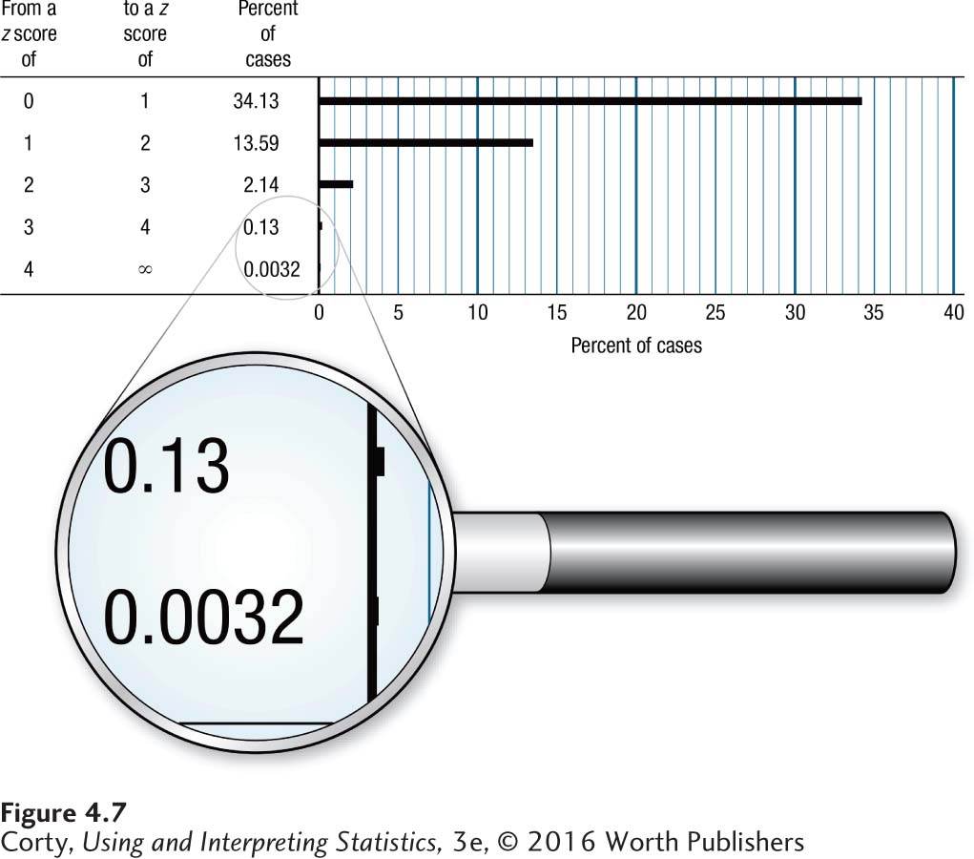
Percentage of Cases Falling in Each Standard Deviation
Note how quickly the percentage of cases falling in each standard deviation decreases as one moves away from the mean.
Only a very small percentage of cases falls more than 3 standard deviations from the mean.
Percentage of Cases Falling in Each Standard Deviation of the Normal Distribution as It Moves Away from the Mean

Slide 15
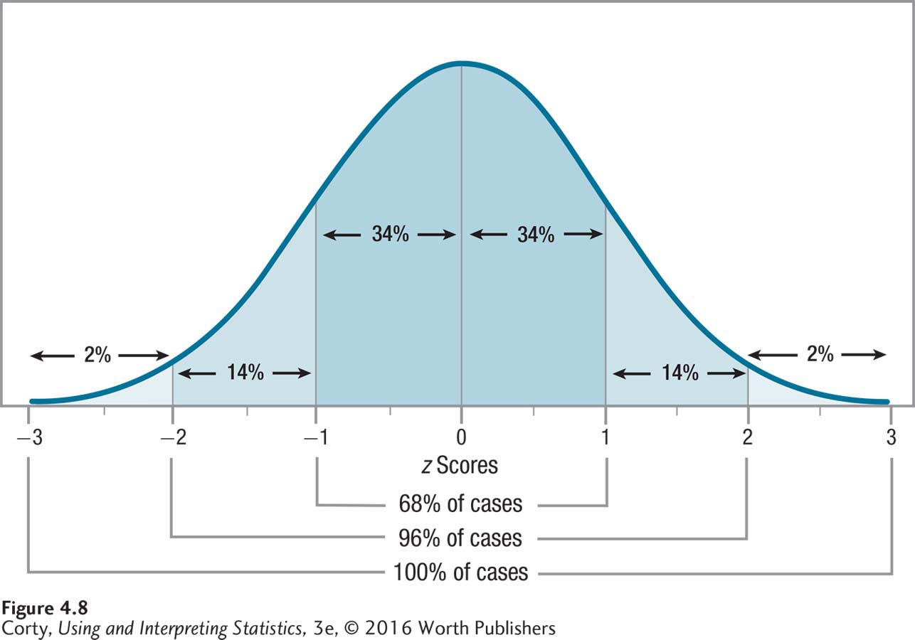
Simplified Version of Normal Distribution
Takes advantage of the fact that almost all cases fall within 3 standard deviations of the mean
Limits the normal distribution to z scores ranging from −3 to +3
Uses rounded percentages for the percentage of cases falling in each standard deviation unit
Simplified Version of the Normal Distribution

Slide 16
Example: How Scores Range: ± 3 Standard Deviations
Example: SAT subtests
z score = −3.00, M = 500, s = 100
raw score of 200 on a subtest
z score = 3.00, M = 500, s = 100
raw score of 800 on a subtest
SAT subtests should range from 200 to 800; almost no one receives a score lower or higher.
Formula Calculating Raw Score (X) from a Standard Score (z)
X = M + (z x s)

Slide 17
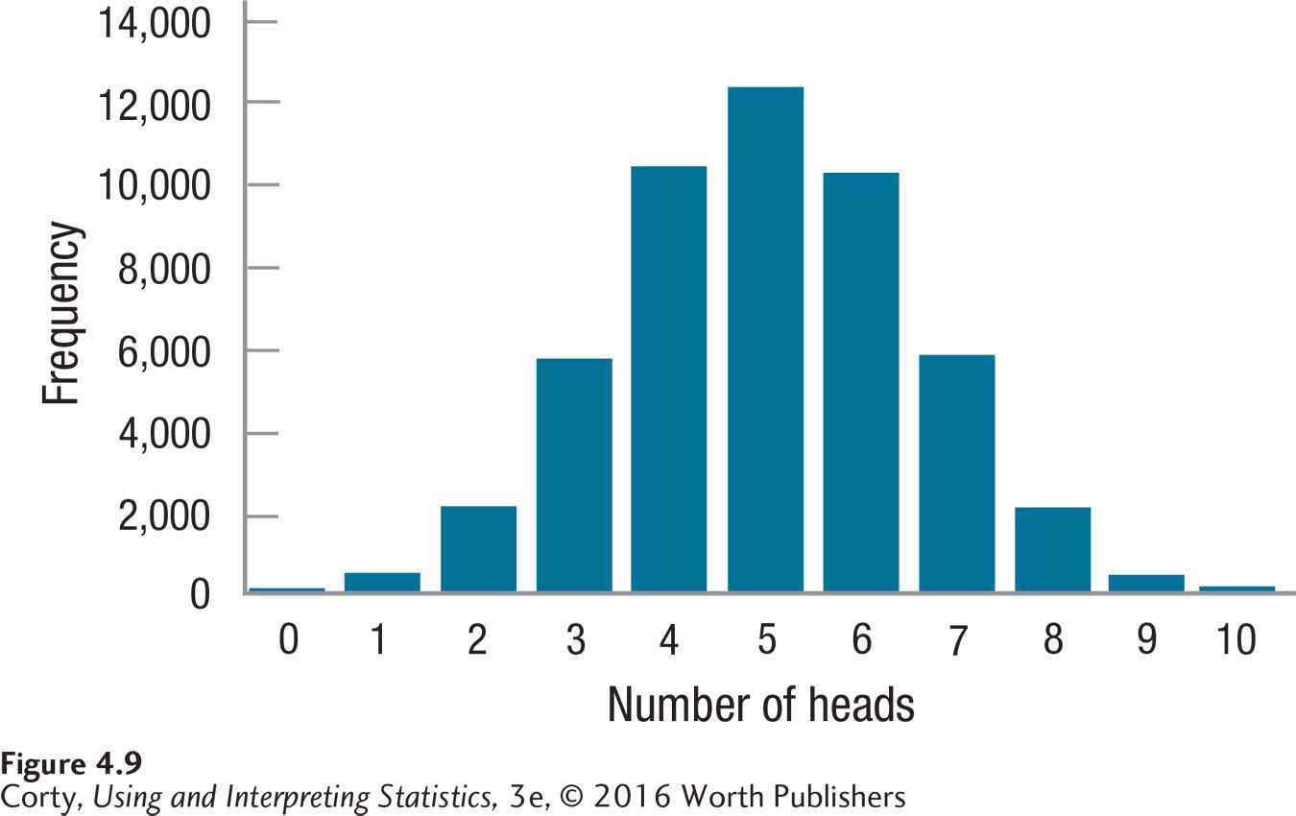
Normal Distribution: “Naturally” Occurring
If one tossed 10 coins 50,000 times and counted the number of heads, the distribution would look like this.
This bar graph for discrete data resembles a normal shape like that seen for a continuous variable.
Approximation of Normal Distribution for Number of Heads for 10 Coins Tossed Together 50,000 Times

Slide 18
Appendix Table 1: Area Under the Normal Distribution
 | A | B | C
z Score | Below +z or Above −z | From Mean to z | Above +z or Below −z
0.50 | 69.15% | 19.15% | 30.85%
0.51 | 69.50% | 19.50% | 30.50%
0.52 | 69.85% | 19.85% | 30.15%
0.53 | 70.19% | 20.19% | 29.81%
0.54 | 70.54% | 20.54% | 29.46%
0.55 | 70.88% | 20.88% | 29.12%
0.56 | 71.23% | 21.23% | 28.77%
0.57 | 71.57% | 21.57% | 28.43%
0.58 | 71.90% | 21.90% | 28.10%
0.59 | 72.24% | 22.24% | 27.76%
Column A
“Body” of distribution
Values will cover 50% or more of the area under the curve
Column B
Mean to z
Values can never be greater than 50%
Column C
“Tail” of distribution
Values will always be less than 50%
This is a section of Appendix Table 1. Note that there are three columns of information for each z score.

Slide 19
z Score Table
Organized by z scores to 2 decimal places
No negative z scores listed; because the normal distribution is symmetrical, the same row can be used when looking up the area under the curve whether for z = 0.50 or −0.50
Columns report the percentage of area under the curve that falls in different sections
Percentages reported are always greater than 0%
Percentages reported can not be greater than 100%
Column A: “body” of the distribution
Column B: mean to z
Column C: “tail” of the distribution

Slide 20
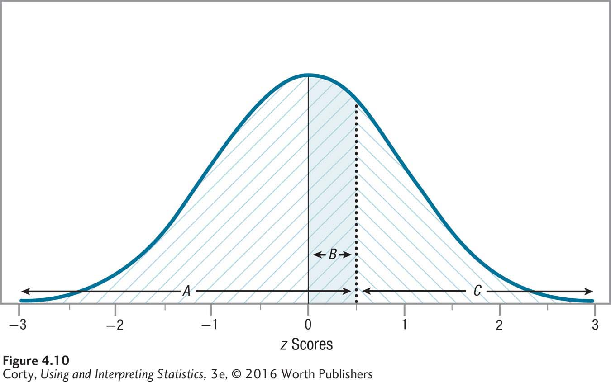
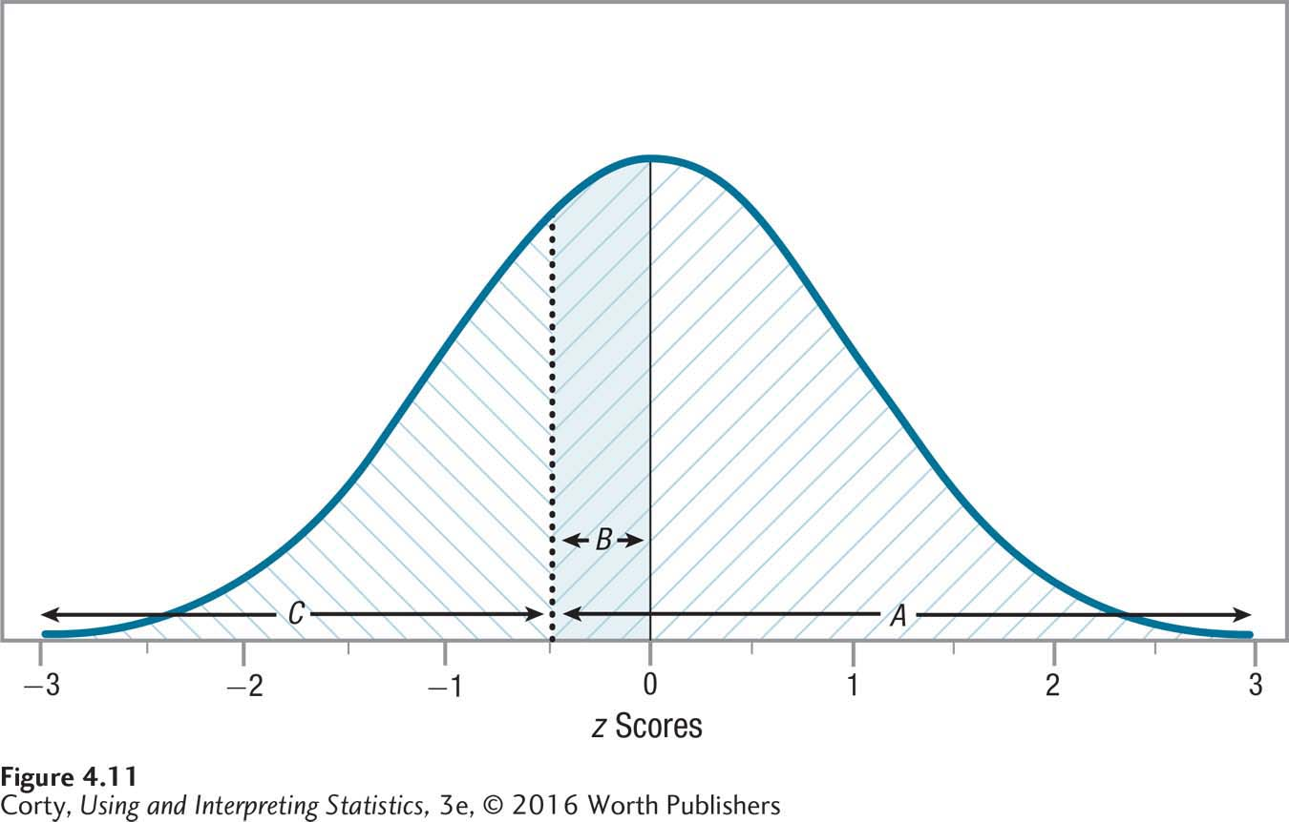
Findings Under Area A/B Under the Curve
Area A – Figure 4.10
Shaded /// (Area B)
Portion of the normal curve that falls below z = 0.50
Area A – Figure 4.11
Shaded /// (Area B)
Changes sides as the sign of the z score changes
Shows the symmetry between positive and negative z scores
Corresponds to column A/B in Appendix Table 1
Finding Areas Under the Curve for a z Score of 0.50
Finding Areas Under the Curve for a z Score of −0.50

Slide 21
Findings Under Area C/B Under the Curve
Area C – Figure 4.10
Shaded \\\ (Area B)
Section that falls above z = 0.50
Area C – Figure 4.11
Shaded \\\ (Area B)
Changes sides as the sign of the z score changes
Shows the symmetry between positive and negative z scores
Corresponds to column C in Appendix Table 1
Finding Areas Under the Curve for a z Score of 0.50
Finding Areas Under the Curve for a z Score of −0.50

Slide 22
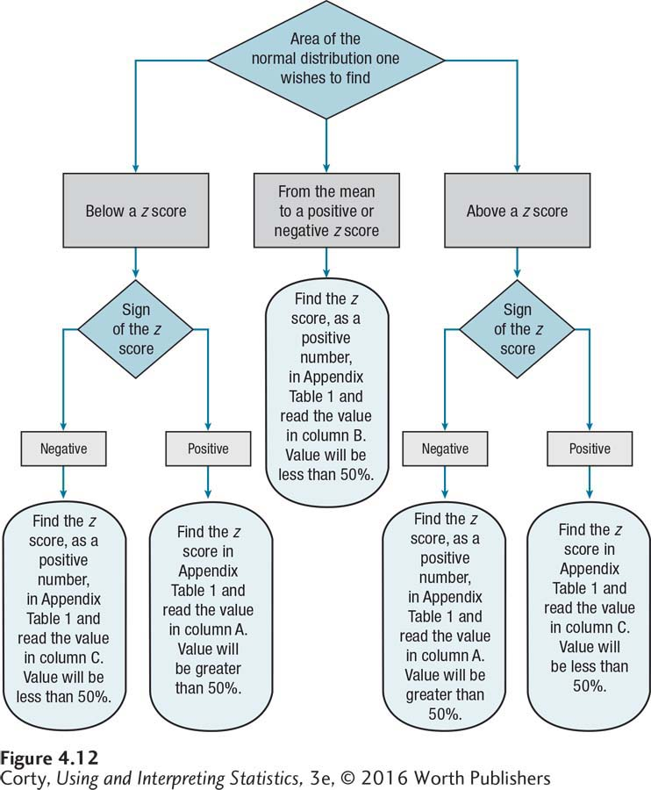
Flowchart for Finding Areas Under the Normal Curve
Choosing Column A, B, or C
Start by making a sketch of the normal distribution.
Shade in the area one wishes to find in order to make a rough estimate.
Use flowchart to determine which column (A, B, or C) of Appendix Table 1 will lead to the exact answer.

Slide 23
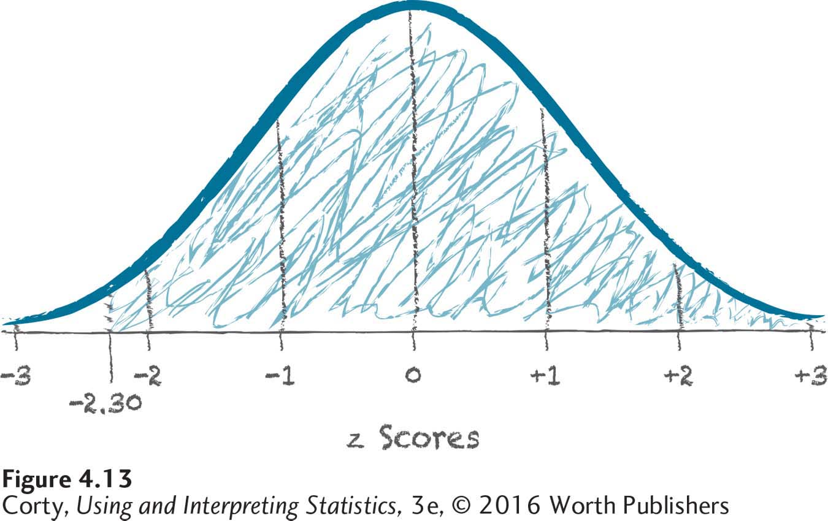
What Percentage of Cases Fall Above a z Score?
Example
What percentage of cases fall above a z score of −2.30?
Make a sketch
Vertical line drawn at z = −2.30
Area to the right of the line is hatched in
Use flowchart in Figure 4.12
Directs you to use Column A
Sketch for Finding Area Above a z Score of −2.30

Slide 24
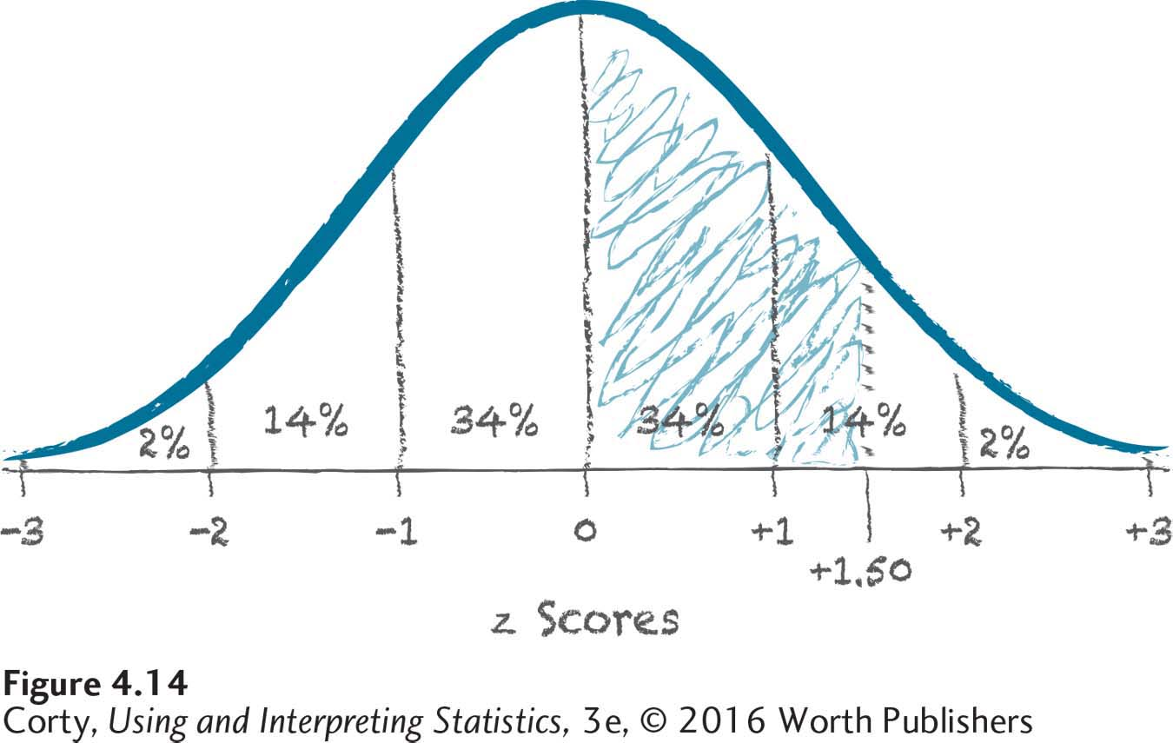
What Percentage of Cases Fall from the Mean to a z Score?
Example
What’s the area from the mean to z score of 1.50?
Make a sketch
Vertical line drawn at z = 1.50
Area from z = 0.00 to z = 1.50 is hatched in
Use flowchart in Figure 4.12
Directs you to use Column B
Sketch for Finding Area from the Mean to a z Score of 1.50

Slide 25
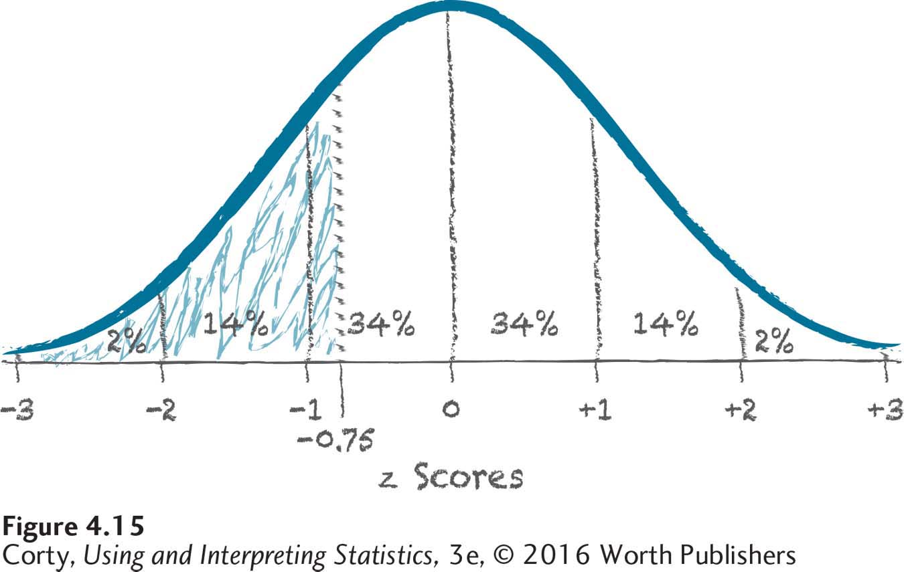
What Percentage of Cases Fall Below a z Score?
Example
What’s the area below a z score of −0.75?
Make a sketch
Vertical line drawn at z = −0.75
Area to the left of this line is hatched in
Use flowchart in Figure 4.12
Directs you to use Column C
Sketch for Finding Area Less Than a z Score = −0.75

Slide 26
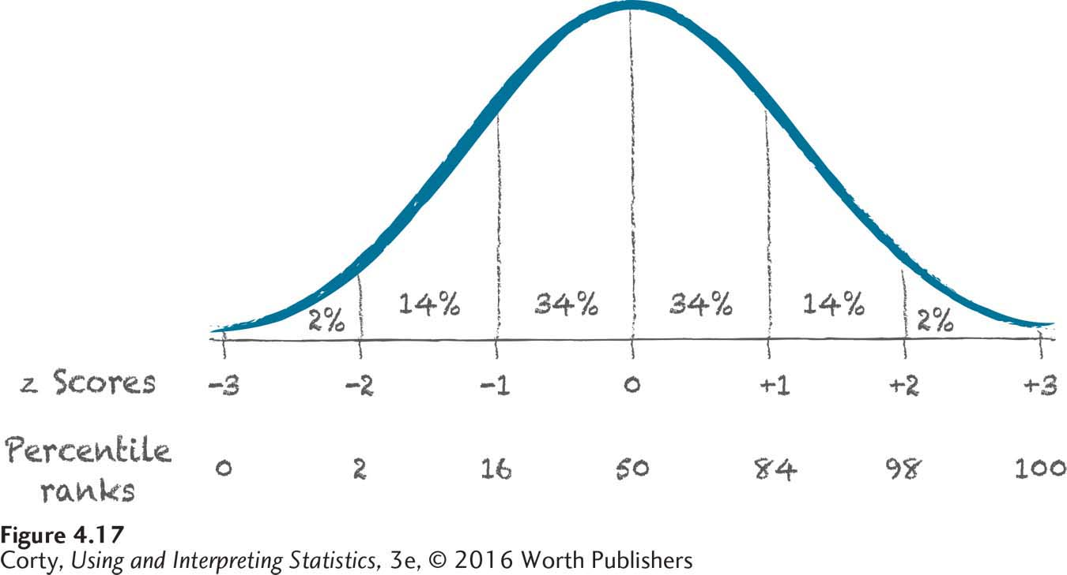
Percentile Ranks
Percentile Rank
Percentage of cases with scores at or below a given level in a frequency distribution
Can be computed from z scores
Express the same information but in a different format
Relationship Among the Area Under the Normal Curve, z Scores, and Percentile Ranks

Slide 27
Percentile Ranks
Example
Leah obtained a score of 600 on SAT subtest
z score = 1.00, M = 500, s = 100
What is Leah’s score expressed as a percentile rank (PR)?
Use Appendix Table 1 to solve
Column A
Relationship Among the Area Under the Normal Curve, z Scores, and Percentile Ranks

Slide 28
Percentile Ranks
Example
Leah obtained a score of 600 on SAT subtest
z score = 1.00, M = 500, s = 100
Percentile rank (PR) = 84.13
Leah did better on this SAT subtest than about 84% of students
Relationship Among the Area Under the Normal Curve, z Scores, and Percentile Ranks

Slide 29
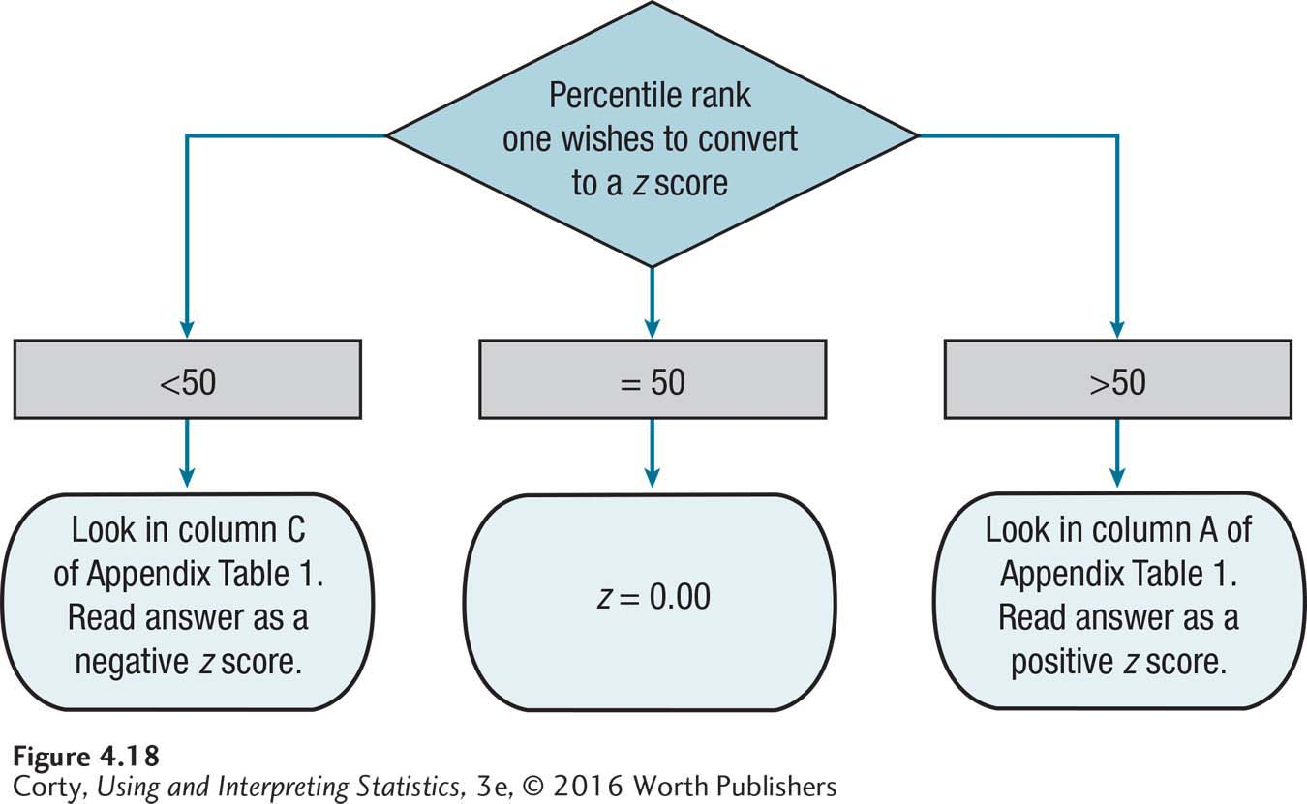
Flowchart for Calculating z Scores from Percentile Ranks
Choosing Column A or C
Make a sketch with both z scores and percentile ranks on the X-axis
Once transformed to a raw score, use formula
X = M + (z x s)
How to Choose: Flowchart for Calculating z Scores from Percentile Ranks

Slide 30
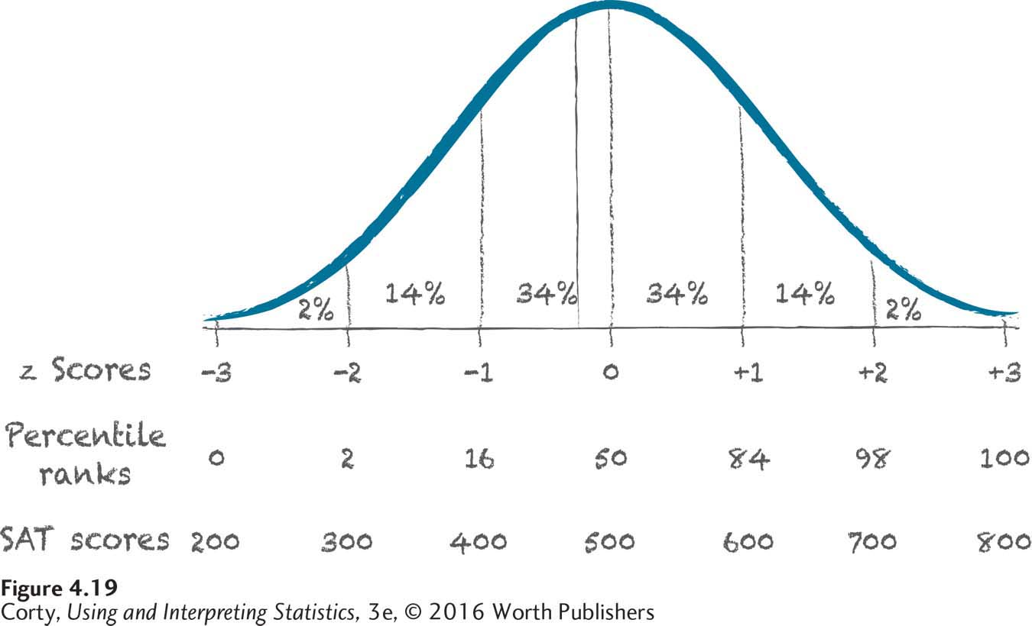
Percentile Ranks
Example
Kelli took SAT subtest, percentile rank of 40.
Make a sketch (see Figure 4.17).
Label X-axis with PR scores and SAT scores.
Use flowchart (see Figure 4.18).
Identify z score that corresponds to 40% in Column C, Table 1:
Z = −0.25
Calculate raw score from standard score.
Sketch for Figuring Out the SAT Score for a Student with a Percentile Rank of 40

Slide 31

Percentile Ranks
Example (continued)
Kelli took SAT subtest, percentile rank of 40.
Calculate raw score from standard score
Kelli obtained a 475 on this SAT subtest.
See Figure 4.19.
$$X=500+(−0.25×100)$$
Sketch for Figuring Out the SAT Score for a Student with a Percentile Rank of 40

Slide 32
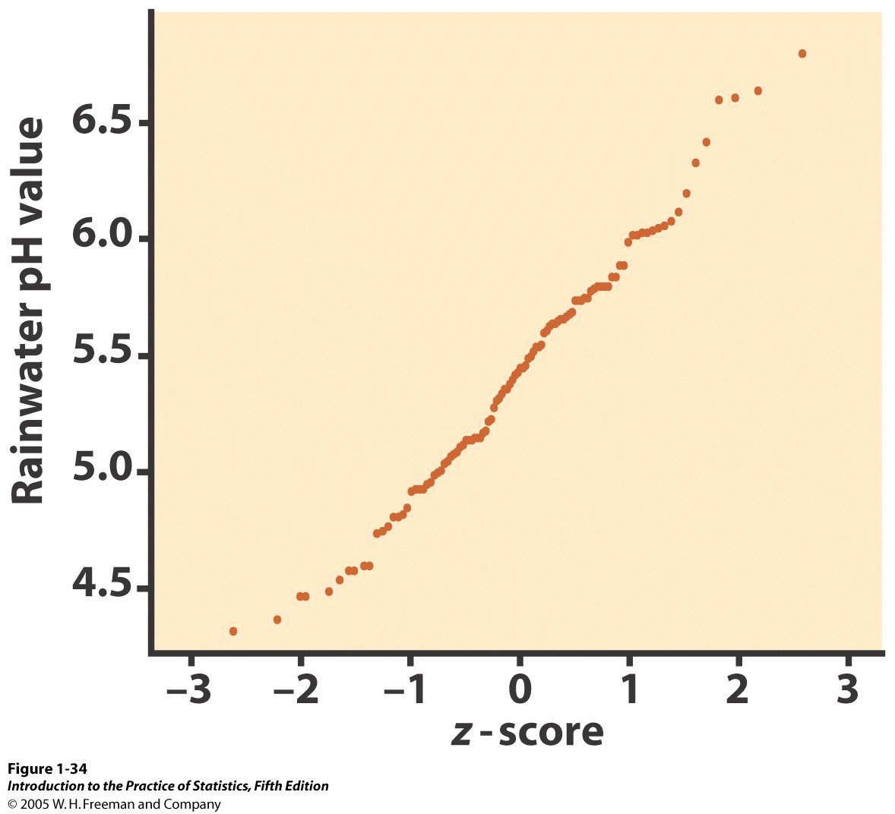
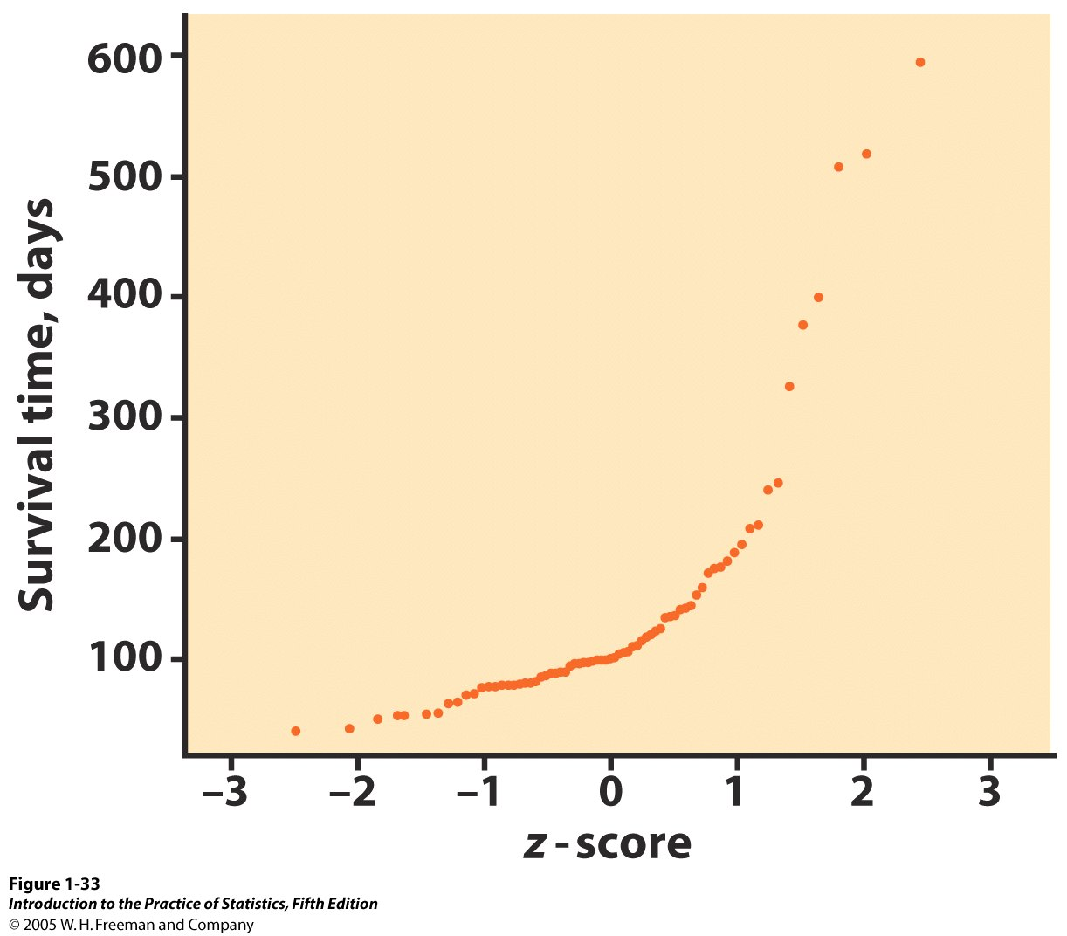
Normal Quantile Plots
One way to assess if a distribution is indeed approximately Normal is to plot the data on a Normal quantile plot.
The data points are ranked and the percentile ranks are converted to z-scores with Appendix Table 1, and plot.
Good fit to a straight line: The distribution of rainwater pH values is close to Normal.
Curved pattern: The data are not Normally distributed. Instead, the data are right skewed: A few individuals have particularly long survival times.

Slide 33
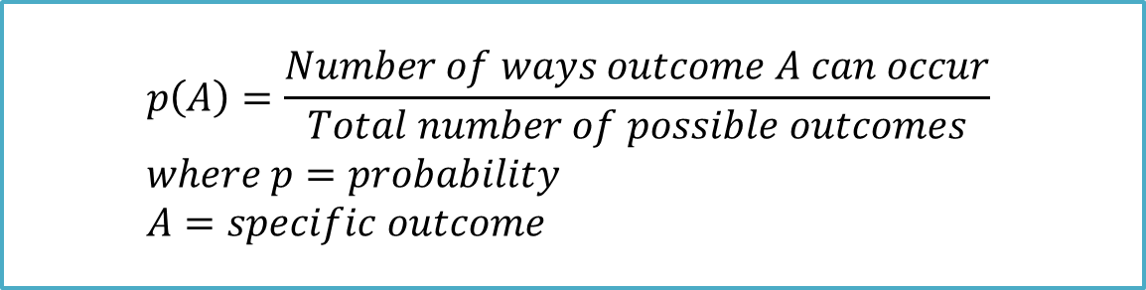
Probability
Probability
Concerns how likely it is that an event or outcome will occur
Is defined as the number of ways a specific outcome (or set of outcomes) can occur, divided by the total number of possible outcomes
$$p\left(A\right)=\frac{Number of ways outcome A can occur}{Total number of possible outcomes} \\ where p=probability \\ A=specific outcome$$

Slide 34
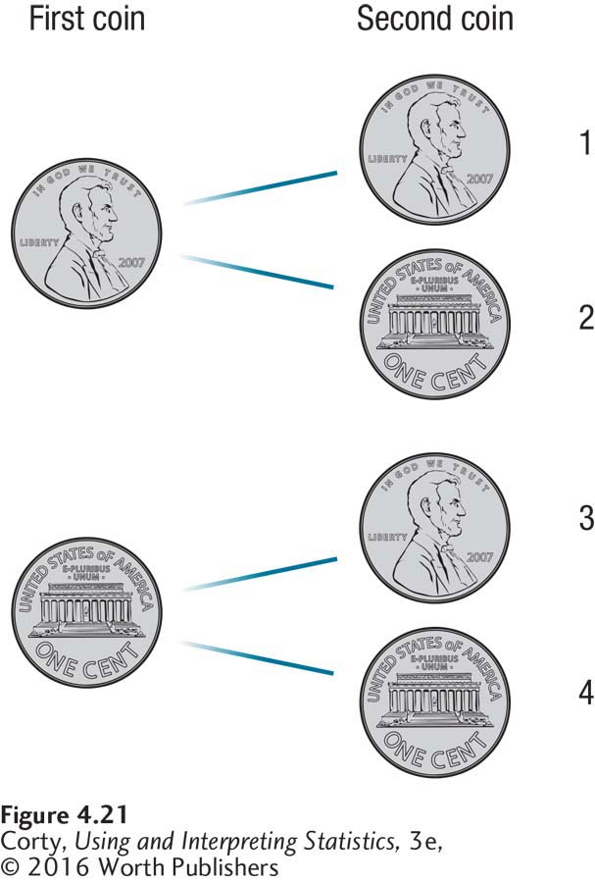
Four Possible Outcomes for Two Coins Being Tossed
The first coin can be either heads or tails and so can the second coin, leading to four unique outcomes.
Each of the four outcomes has one chance in four of occurring, so the probability of each outcome is ¼

Slide 35
Probabilities, Expressed as Proportions, for the Three Outcomes for Two Coins Being Tossed
Outcome | Probability
Two heads (HH) | .25
One heads and one tails (HT or TH) | .50
Two tails (TT) | .25
There are three possible outcomes if two coins are tossed.
The sum of the probabilities for all three outcomes is 1.00.

Slide 36
Finding z Scores Associated with Middle and Extreme Percentages
Table 4.4: How to Choose: Finding z Scores Associated with Middle and Extreme Percentages of the Normal Distribution
Finding z Scores Associated with a Middle Percentage of the Normal Distribution
Step 1. Take the middle percentage and cut it in half.
Step 2. Use column B of Appendix Table 1 to find the percentage closest to the ½ value calculated in Step 1.
Step 3. Report the z score for the percentage in ± format.
Finding z Scores Associated with an Extreme Percentage of the Normal Distribution
Step 1. Take the extreme percentage and cut it in half.
Step 2. Use column C of Appendix Table 1 to find the percentage closest to the ½ value calculated in Step 1.
Step 3. Report the z score for the percentage in ± format.
These guidelines help one calculate the percentage of cases, in a normal distribution, that fall in the middle or in the two tails.

Slide 37
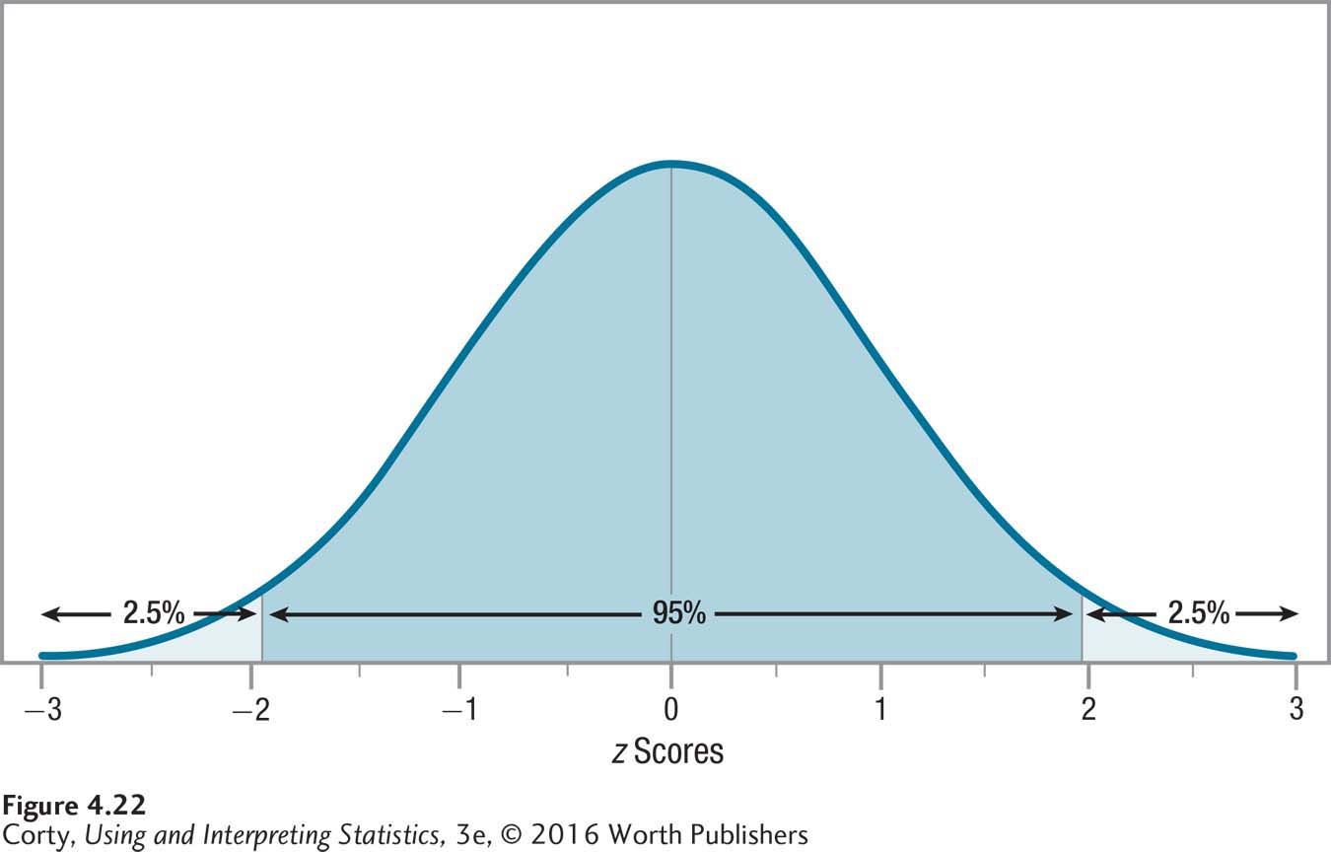
Middle and Extreme Sections of the Normal Curve Associated with z scores of ±1.96
Extreme Percentage
Percentage of the normal distribution that is found in the two tails and that is evenly divided between them
Same z scores ± 1.96 mark off the middle 95% of scores
Also marks off the extreme 5% of scores
1.96 appears in many chapters—remember what it represents
The same z scores, ±1.96, that mark off the middle 95% of scores also mark off the extreme 5% of scores.

